Slide 1
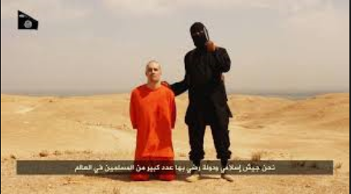
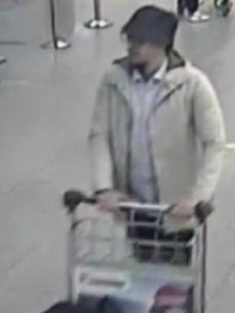
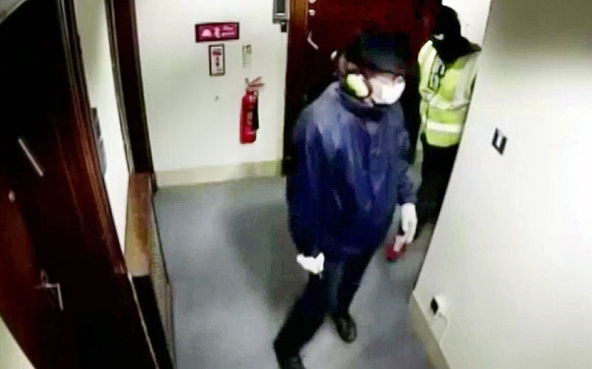
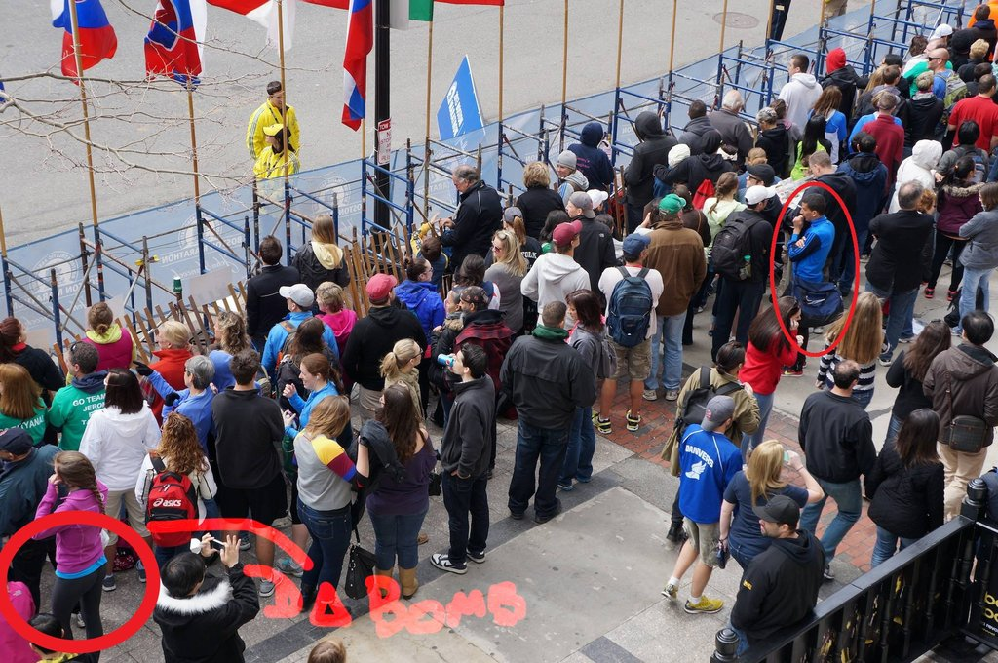
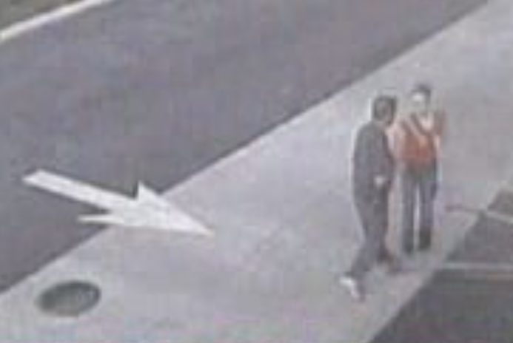
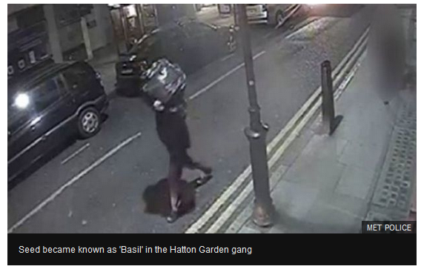
Identifying people by their gait A summary of progress
ACCV Human ID at a Distance HID 2020
Mark Nixon
University of Southampton UK

Slide 2
1. Where are we now? 2. How did we get here? 3. Where are we going?
Identifying people by their gait A summary of progress

Slide 3
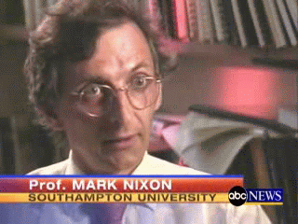
Gait biometrics
As a biometric, gait is available at a distance when other biometrics are obscured or at too low resolution
ABC News, July 13 2006

Slide 4
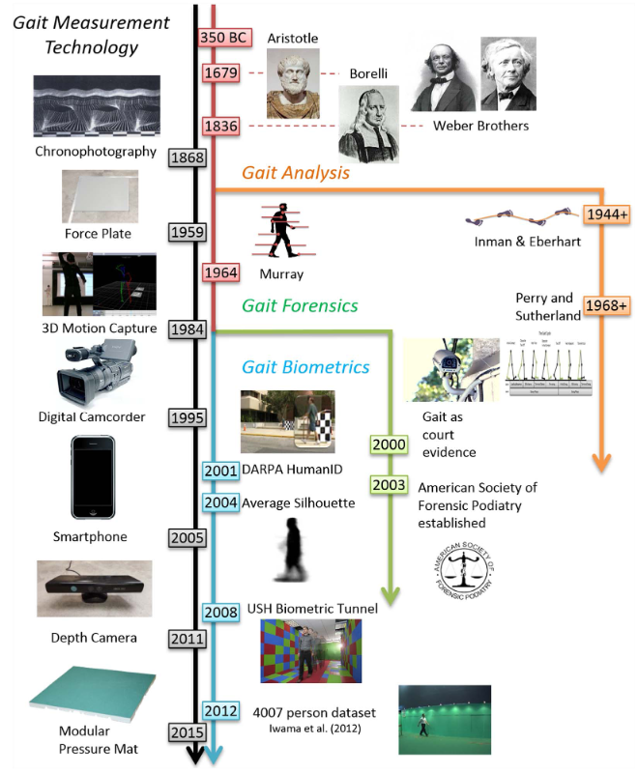
2000 years of progress
As a biometric, gait is available at a distance when other biometrics are obscured or at too low resolution
It is now widely accepted that people can be recognised by their gait
This is a consequence of desire, need and research, together with technological advance
Connor and Ross, Biometric recognition by gait, CVIU 2018
Notes:
Where is Shakespeare?

Slide 5
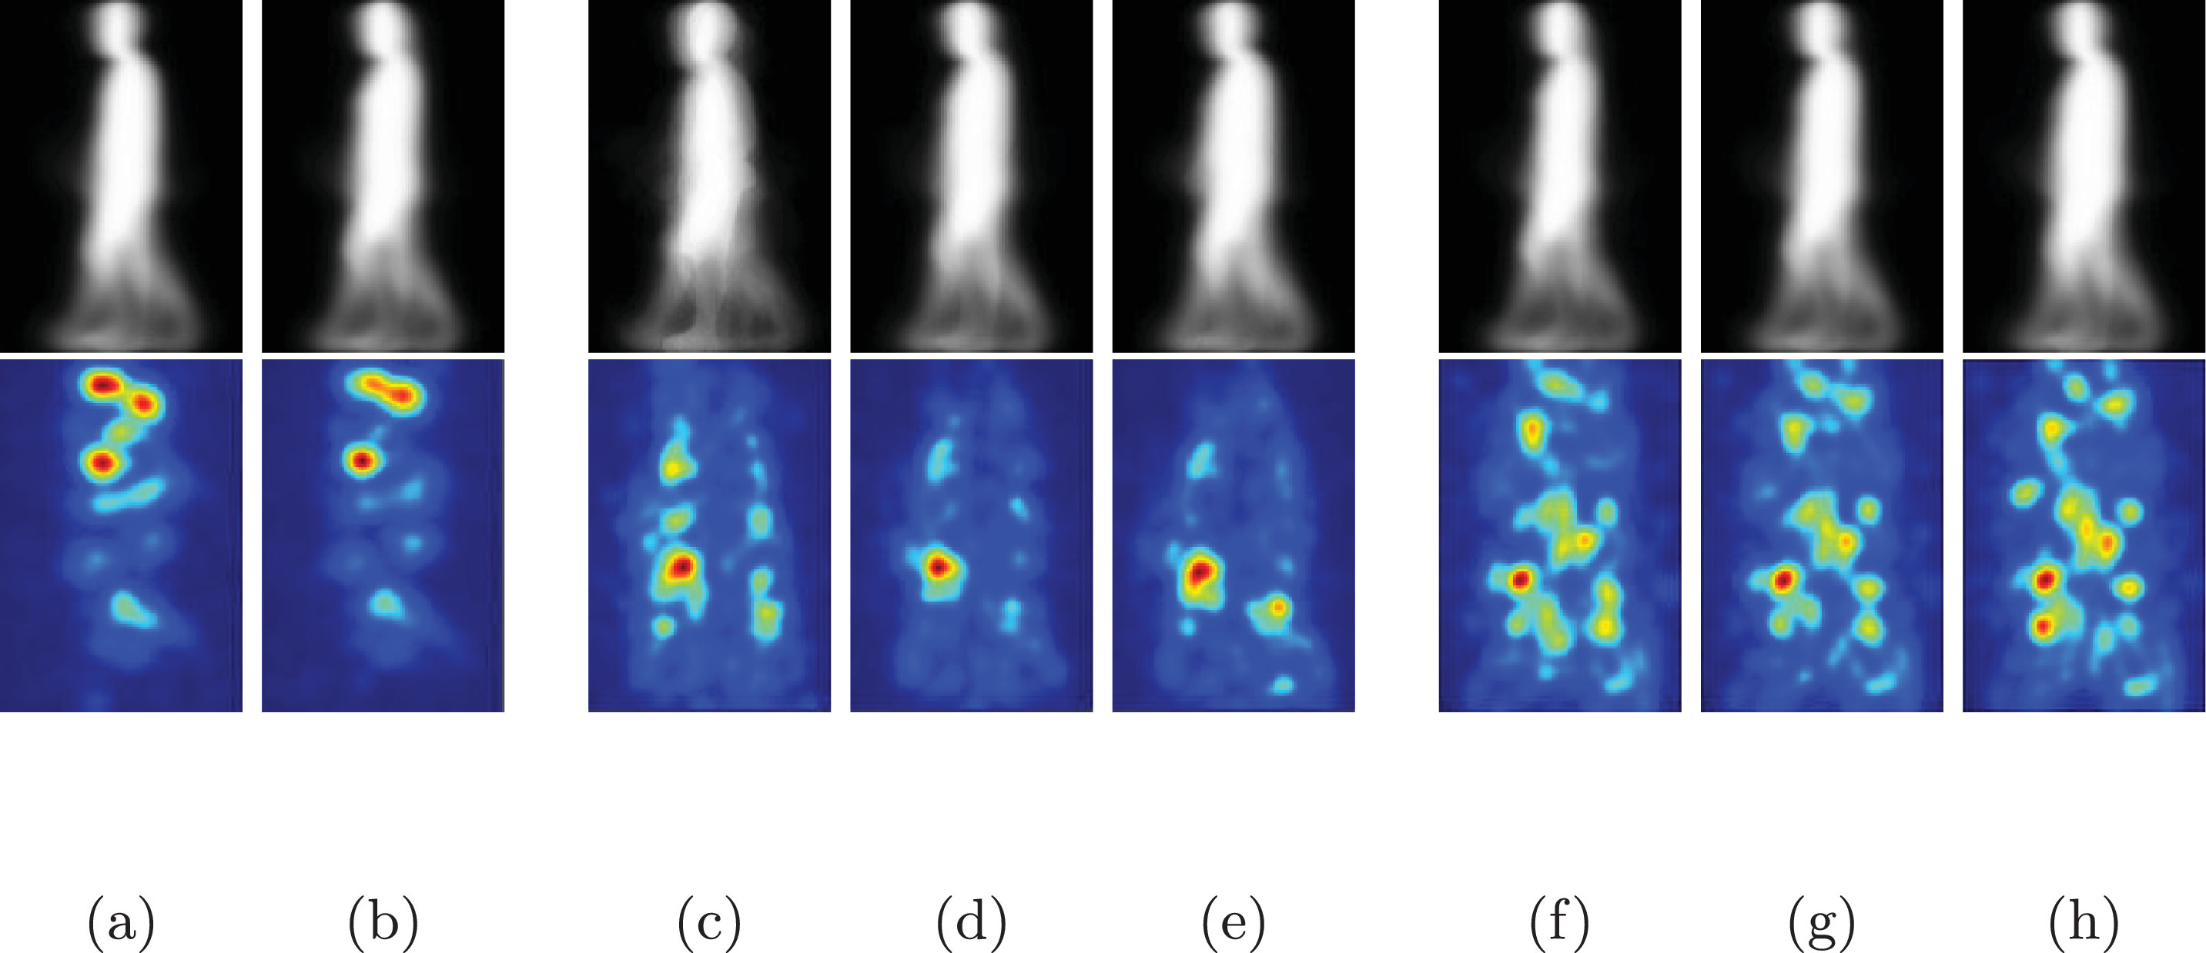
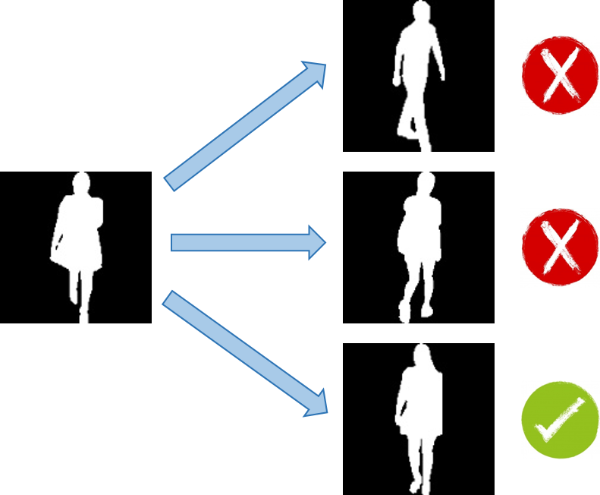
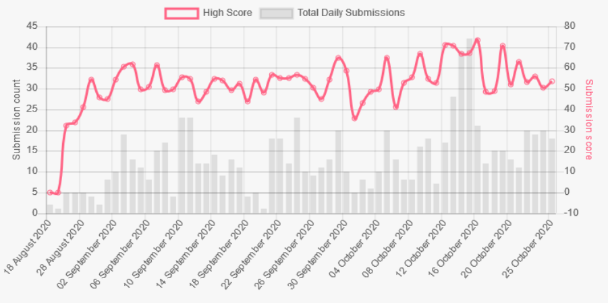
HiD competition, ACCV 2020
Top row: GEI for male, female, child, middle-aged, old, slim, medium and overweight.
Bottom row: corresponding visualization
CASIA E GEIs
https://competitions.codalab.org/competitions/26085#learn_the_details
Notes:
CASIA-E [40]. It involves 1014 people with identity and corresponding soft biometrics. The dataset includes 3 types of scenes (simple static background scene#1, complex static background scene#2, and complex dynamic background scene#3), 2 vertical views (L: low vertical view with a height of 1.2 m and H: high vertical view with a height of 3.5 m), 13 horizontal views (from 0∘to 180∘at an interval of 15∘) and 3 different walking conditions (NM: normal walking, CL: with a coat and BG: with a bag).
Note the change in b/g complexity in CASIA E

Slide 6
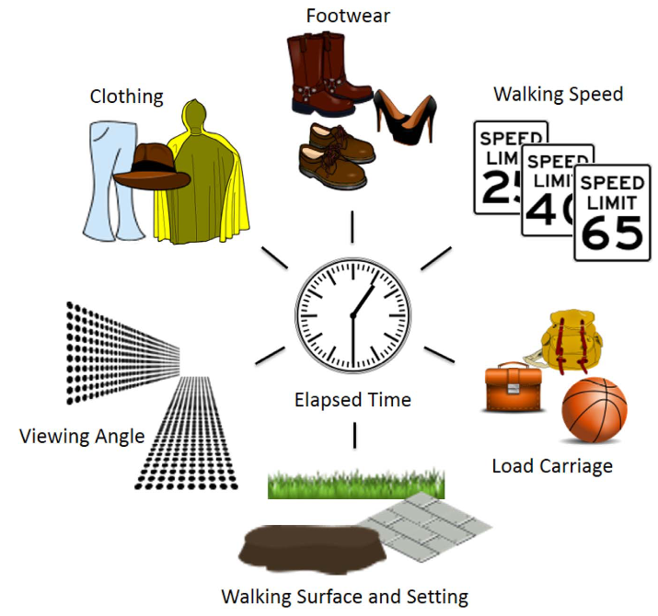
What changes?
Many covariates can affect walking style
…. + health, drugs, mood,
…. but walking is a natural part
of our daily lives

Slide 7
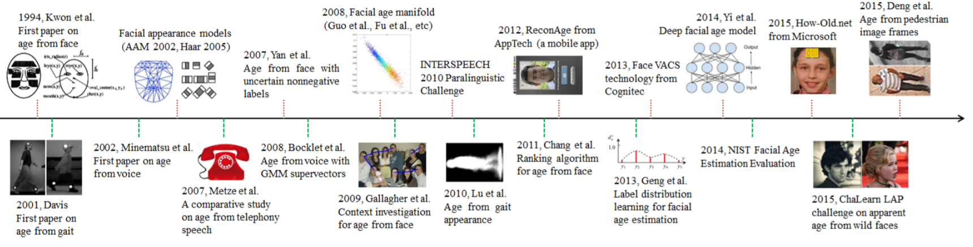
Biometrics and identity science
Major milestones in the history of automatic age estimation from biometric data
Sun, Zhang, Sun, Tan IEEE TPAMI 2018

Slide 8
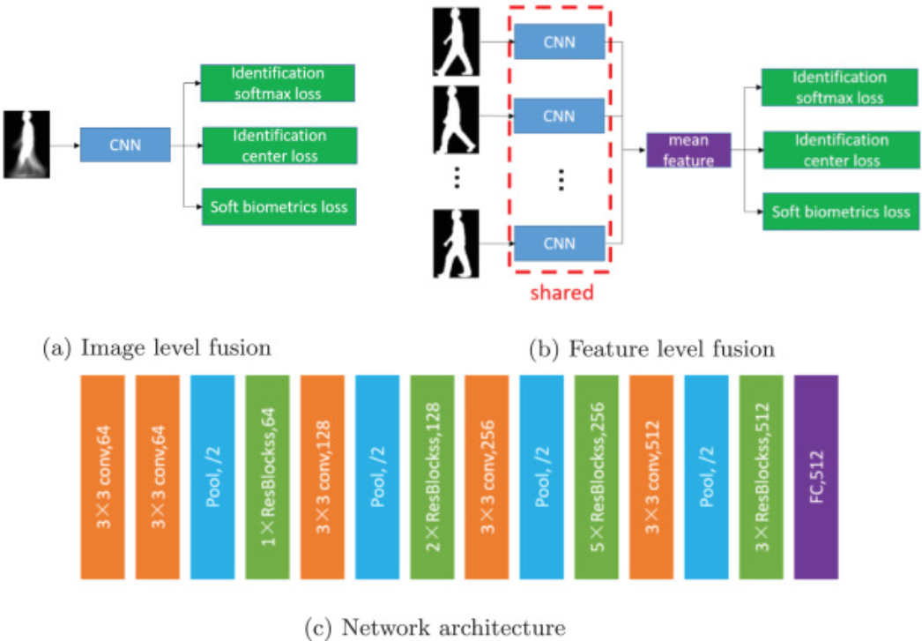
Hand crafted then; deep learning now
Y Zhang, Y Huang, L Wang, S Yu, Pattern Recognition, 2019

Slide 9
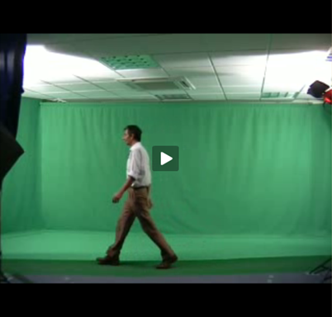
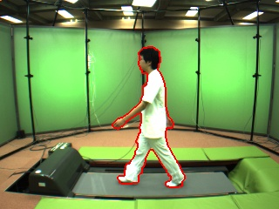
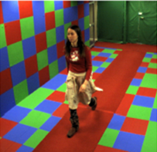
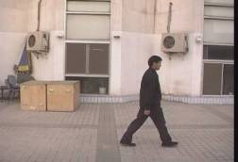
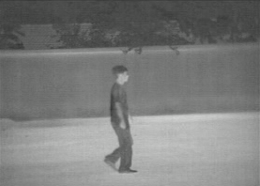
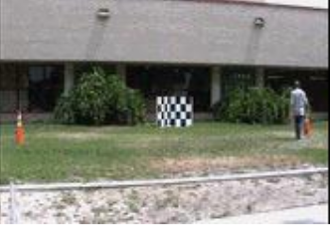
Gait biometrics databases
Laboratory
Southampton 3D and 2D
CASIA (+ multiview, thermal)
Osaka OU-ISIR (+ multiview)
‘Real’ World
HumanID
Southampton
CASIA
+ accelerometer, footfall, medical
M Okumura, Y Makihara, Y Yagi, IEEE TIFS 2012

Slide 10
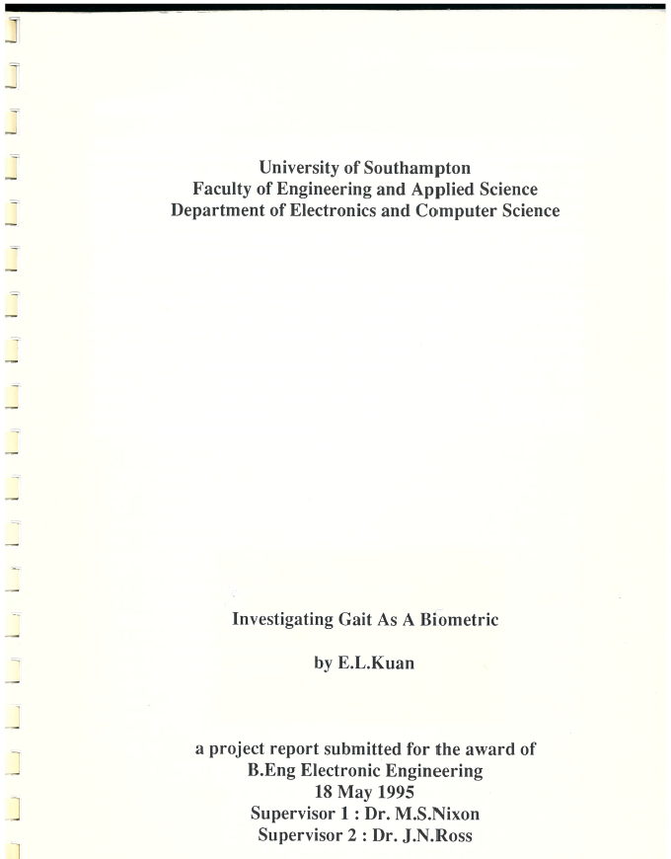
1. Where are we now? 2. How did we get here? 3. Where are we going?
Identifying people by their gait A summary of progress

Slide 11
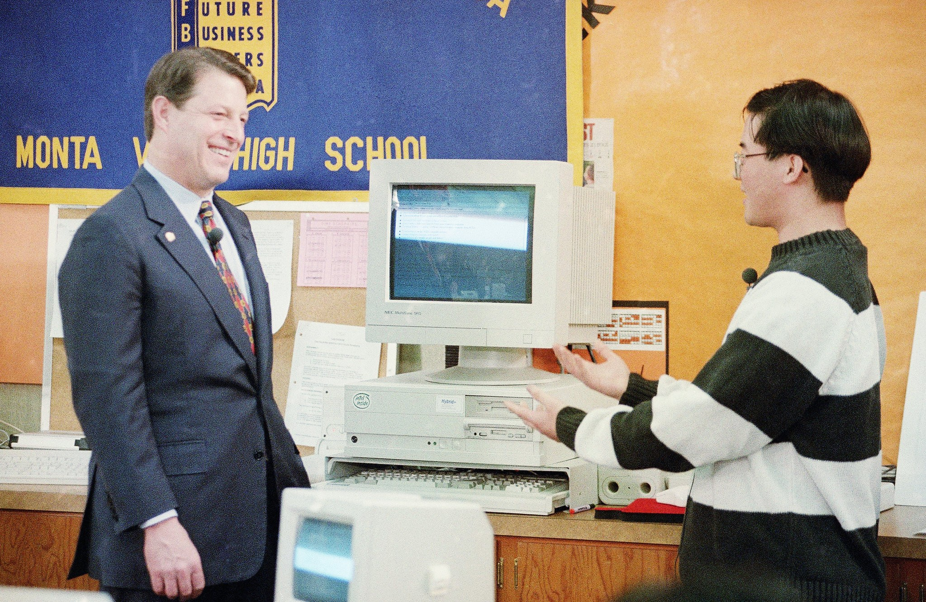
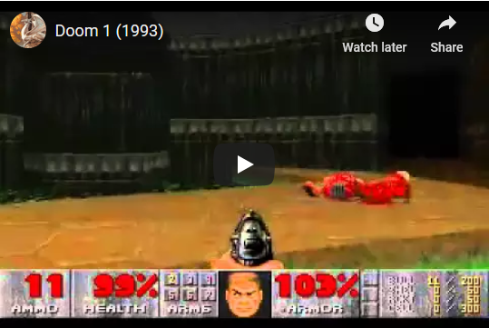
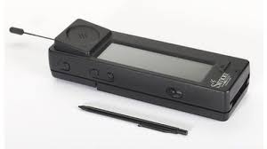
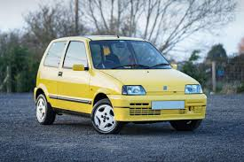
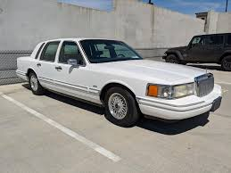
Technology in 1994
Notes:
Vice President Al Gore smiles as high school student Mark Wang, right, demonstrates an on-line interactive computer system in a computer class during Gore's visit to Monta Vista High School in Cupertino, California, Wednesday, Jan. 12, 1994
Windows 95 was a year away
Simon was released 1994. It was called Simon coz it was simple…

Slide 12
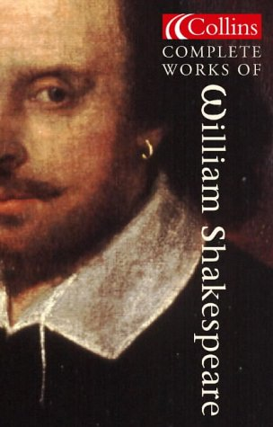

Gait and literature
Dictionary: “manner of walking”
Shakespeare observed recognition:
“High’st Queen of state; Great Juno comes; I know her by her gait” [The Tempest]
“For that John Mortimer….in face, in gait in speech he doth resemble” [Henry IV/2]
Other literature: e.g. Band of Brothers: “I noticed this figure coming, and I realized it was John Eubanks from the way he walked”

Slide 13
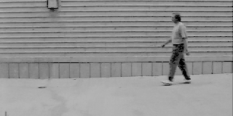
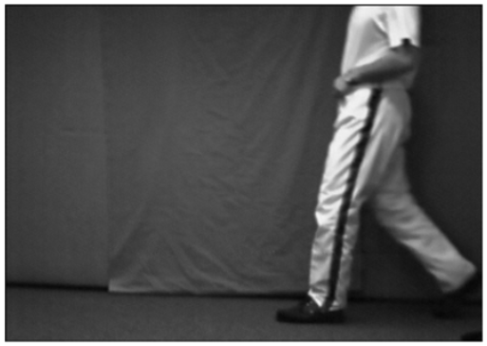
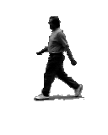
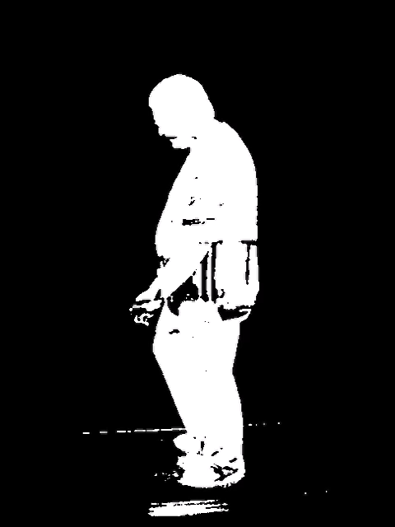
Early data
6 subjects; 7 sequences
Sony Hi8 video camera
Circular track ….exhausted subjects?
Little and Boyd, Videre, 1998

Slide 14
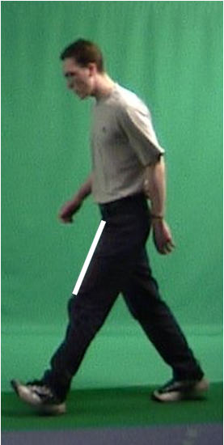
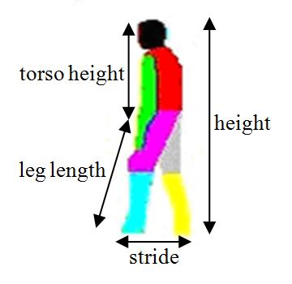
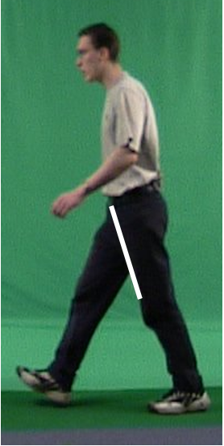
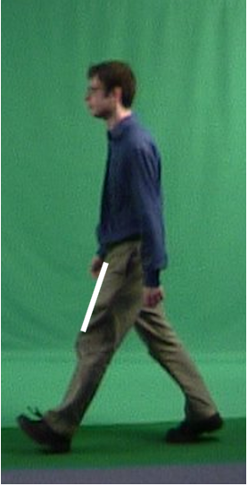
Model-based recognition
Inclination of thigh
Magnitude of DFT
Other models are possible
Difference between magnitude
Difference between phase
D Cunado, MS Nixon, JN Carter, Proc. AVBPA, 1997

Slide 15
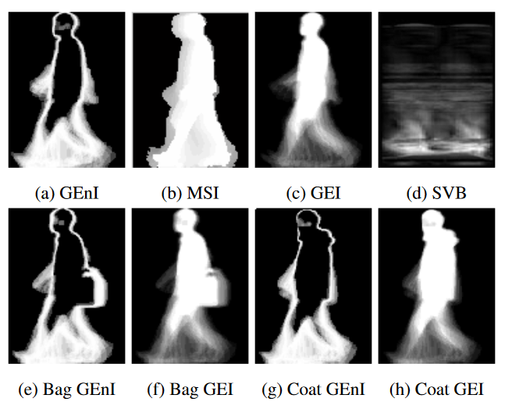
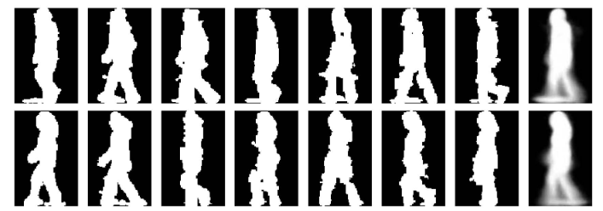
Using silhouettes
Some names: average silhouette, GEI
Gait Energy Image
Gait Entropy Image
J Han, B Bhanu, IEEE TPAMI, 2005
Notes:
Gait Entropy Image (GEnI),Motion Silhouette Image (MSI), Gait Energy Image (GEI), and Shape Variation Based (SVB)

Slide 16
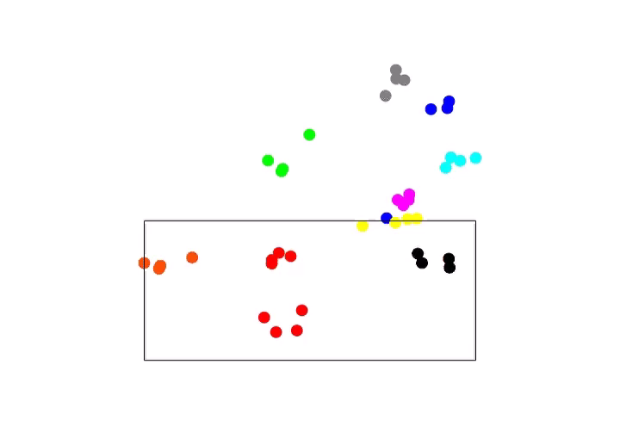


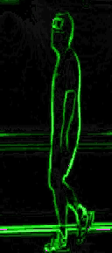
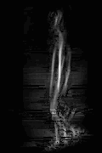
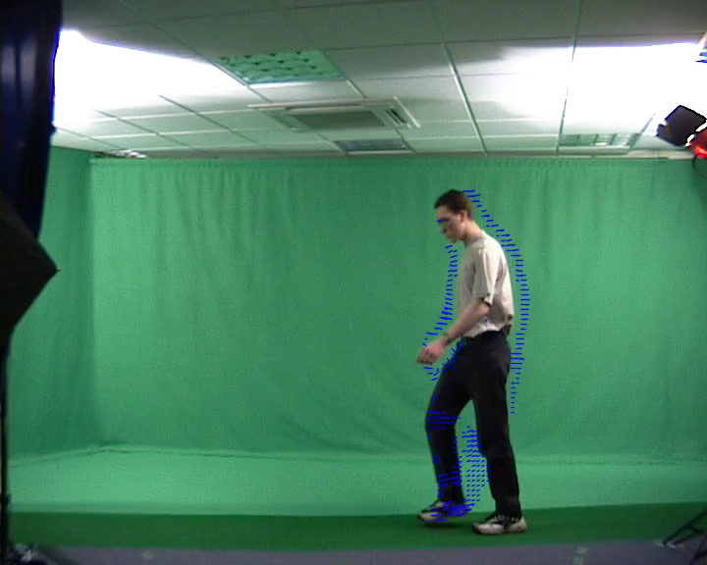
Many gait representations possible
Recognising people from the motion of the whole body
silhouette
flow
edges
symmetry
acceleration
feature space
MS Nixon, T Tan, R Chellappa, Springer, 2005

Slide 17
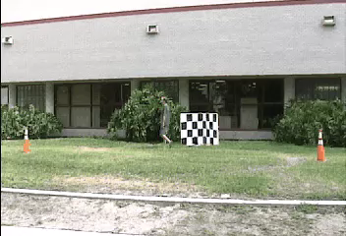


DARPA’s Human ID at a Distance
S Sarkar, PJ Phillips, Z Liu, IR Vega, P Grother, KW Bowyer, IEEE TPAMI 2005

Slide 18
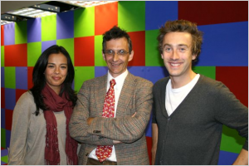
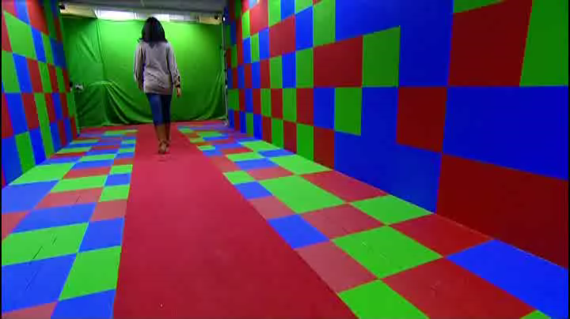
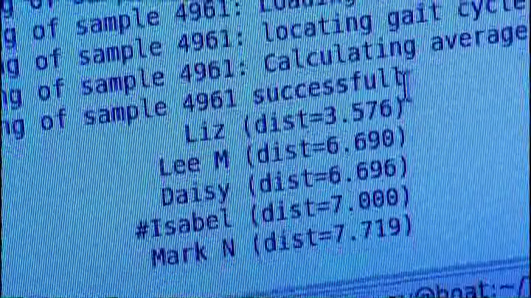

Does gait biometrics really work?
https://www.youtube.com/watch?v=PUwlNc0xAgQ
BBC1 Bang Goes the Theory Episode 1, 2009

Slide 19
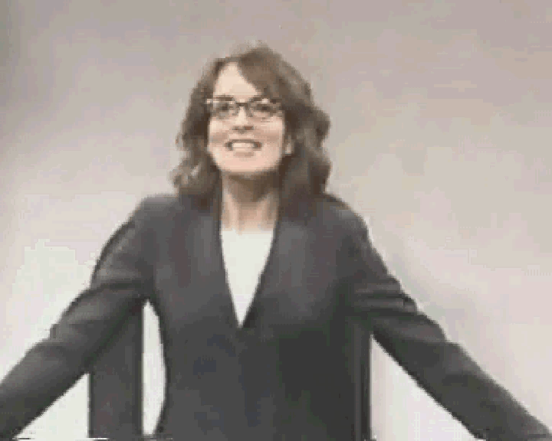
US demonstration ……
Saturday Night Live 2002
Notes:
Tina Fey at the start of her career

Slide 20
1. Where are we now? 2. How did we get here? 3. Where are we going?
Identifying people by their gait A summary of progress

Slide 21
Identity science
Science/ technology
Covariates and exploratory variables
Soft biometrics
Spoofing
Deep architectures
Applications
Medicine (dementia, balance, falls)
Sports
Security
Marketing

Slide 22
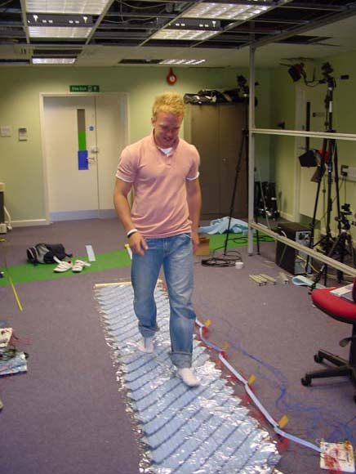
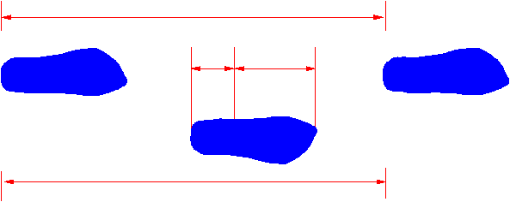

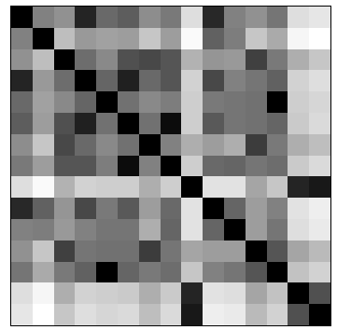

The first intelligent carpet
time
t_{S}
t_{H}
t_{T}
L_{S}
distance
192×32 binary sensor array
Middleton, Buss and Nixon, AutoID 2005

Slide 23
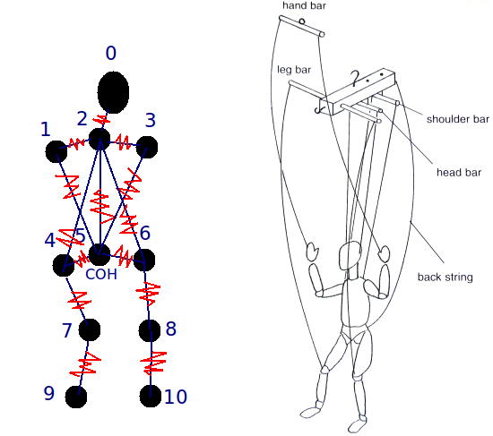


3D recognition – marionette based
Ariyanto and Nixon, Proc. ICB 2013

Slide 24





Gait as evidence: murder case in Australia 2014
Bouchrika, Nixon, Carter, J. Forensic Science 2011, and Eusipco 2010
https://www.youtube.com/watch?v=F1b_apXjjV0&feature=youtu.be

Slide 25



Descriptions and attributes for identification
Image of crime
Eyewitness statement
Generate description
“24 year old male average height
wearing shirt”
Subject | Gender | Age | Height | Nose W | Top
? | M | 24 | 171 | 2.4 | Shirt
Database of images
Subject | Gender | Age | Height | Nose W | Top
123456 | M | 25 | 172 | 2.3 | Shirt
123457 | F | 36 | 156 | 2.2 | Blouse
123458 | M | 58 | 182 | 1.2 | T shirt
Database of descriptions
Generate descriptions
Martinho-Corbishley, Nixon and Carter, IEEE TPAMI 2019
Notes:
This is zero shot ID. We want to go from description to identification.
The main question here is what can we learn from human vision. We don’t impose categories and see how much the image matches them. We do ID by asking for fine grained semantic categories, and then see if we can learn them from the images.
Note that Re-ID is largely about image matching and needs images from same viewpoint. It’s not attribute based search as ours are fine grained.

Slide 26


Recent works
SE Bekhouche, A Chergui, A Hadid…, ICIP 2020
Z Zhang, L Tran, F Liu , X Liu, IEEE TPAMI 2019

Slide 27

Conclusions
Yes, gait works
Society will benefit more
The technology is grounded in science, literature, medicine + ….
We have more to learn
Congratulations to: Beijing Jiaotong University
Sichuan University
Harbin Engineering University
University of Science and Technology of China
and to all participants
Thanks to: Shiqi Yu and all organisers, CASIA (dataset), Watrix (sponsorship)
Notes:
This is zero shot ID. We want to go from description to identification.
The main question here is what can we learn from human vision. We don’t impose categories and see how much the image matches them. We do ID by asking for fine grained semantic categories, and then see if we can learn them from the images.
Note that Re-ID is largely about image matching and needs images from same viewpoint. It’s not attribute based search as ours are fine grained.

Slide 28
Selection of further reading
Using gait as a biometric, via phase-weighted magnitude spectra, D Cunado, MS Nixon, JN Carter, Proc. AVBPA, 1997
The humanid gait challenge problem: Data sets, performance, and analysis, S Sarkar, PJ Phillips, Z Liu, IR Vega…, IEEE TPAMI, 2005
Individual recognition using gait energy image, J Han, B Bhanu, IEEE TPAMI, 2005
Human identification based on gait, MS Nixon, T Tan, R Chellappa, Springer, 2005
The OU-ISIR gait database comprising the large population dataset and performance evaluation of gait recognition, M Okumura, Y Makihara, Y Yagi, IEEE TIFS 2012
Biometric recognition by gait: A survey of modalities and features, P Connor, A Ross, Computer Vision and Image Understanding, 2018
Demographic analysis from biometric data: Achievements, challenges, and new frontiers Y Sun, M Zhang, Z Sun, T Tan, IEEE TPAMI 2018
A comprehensive study on gait biometrics using a joint CNN-based method, Y Zhang, Y Huang, L Wang, S Yu, Pattern Recognition, 2019
On learning disentangled representations for gait recognition, Z Zhang, L Tran, F Liu, X Liu… IEEE TPAMI, 2019
Kinship Verification From Gait?, SE Bekhouche, A Chergui, A Hadid… Proc. IEEE ICIP, 2020
Apologies if your own technique is missing, or your favourite. There are many more.

Slide 29
And thanks to ….
Dr John Carter, Dr Sasan Mahmoodi, Dr Jon Hare
Dr Hani Muammar, Dr Adrian Evans, Prof. Xiaoguang Jia, Prof Yan Chen, Prof Steve Gunn, Dr Colin Davies, Dr Mark Jones, Dr Alberto Aguado, Dr David Cunado, Dr Jason Nash, Prof Ping Huang, Dr David Benn, Dr Liang Ng, Dr Mark Toller, Dr John Manslow, Dr Mike Grant, Dr Jamie Shutler, Dr Karl Sharman, Prof Andrew Tatem, Layla Gordon, Dr Richard French, Dr Vijay Laxmi, Dr James Hayfron-Acquah, Dr Chew-Yean Yam, Dr Yalin Zheng, Dr Jeff Foster, Dr Jang Hee Yoo, Dr Nick Spencer, Dr Stuart Prismall, Wan Mohd.-Isa, Dr Peter Myerscough, Dr Richard Evans, Dr Stuart Mowbray, Dr Rob Boston, Dr Ahmad Al-Mazeed, Prof Peter Gething, Dr Dave Wagg, Dr Alex Bazin, Dr Mike Jewell, Dr Lee Middleton, Dr Galina Veres, Dr Imed Bouchrika, Dr Xin Liu, Dr Cem Direkoglu, Hidayah Rahmalan, Dr Banafshe Arbab-Zavar, Dr Baofeng Guo, Dr Sina Samangooei, Dr Michaela Goffredo , Dr Daniel Thorpe, Dr Richard Seely, Dr John Bustard, Dr Alastair Cummings, Dr Muayed Al-Huseiny, Dr Mina Ibrahim, Dr Darko Matovski, Dr Gunawan Ariyanto, Dr Sung-Uk Jung, Dr Richard Lowe, Dr Dan Reid, Dr George Cushen, Dr Ben Waller, Dr Nick Udell, Dr Anas Abuzaina, Dr Thamer Alathari, Dr Musab Sahrim, Dr Ah Reum Oh, Dr Tim Matthews, Dr Emad Jaha, Dr Peter Forrest, Dr Jaime Lomeli, Dr Dan Martinho-Corbishley, Dr Bingchen Guo, Dr Jung Sun, Dr Nawaf Almudhahka, Tom Ladyman, Dr Wenshu Zheng, Di Meng, Moneera Alnamnakani
Sponsors: EPSRC, Home Office, MoD (GD), DARPA, ARL, EU

